Slide 1
Road Safety and vehicle registrations and safety
Parth Sheth
1711055

Slide 2
The Automobile Effect
The increased Automobile count has the following effects:
Decreased time constraints between two places due to automobile travel.
Decreased neighbourhood interaction as loneliness leads to individual migrate to different places.
Increased Global Warming and CO2 levels
Increased number of Deaths due to road accidents.
Decreasing levels of natural resources.
Increased levels of congestion.

Slide 3
Increased levels of Noise Pollution
Increased Air Pollution.
Drastic Climatic Changes.
Increased cost of and dependency on energy resources.
Thus we can see there are both advantages and disadvantages of the increasing count of the Automobile on roads.

Slide 4
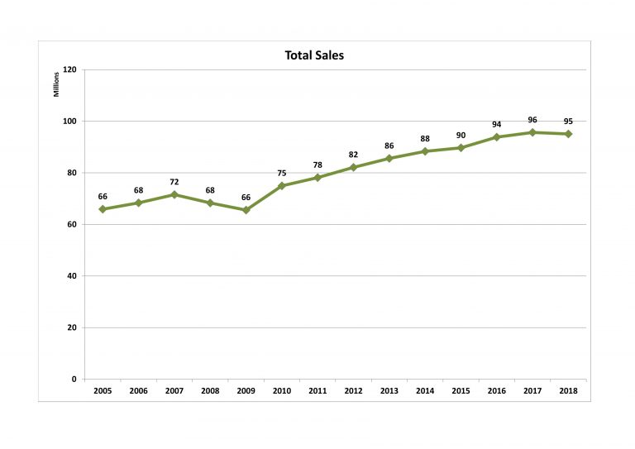
Vehicle Population World-Wide
This line graph shows the total number of vehicles sold (in millions)till 2018

Slide 5
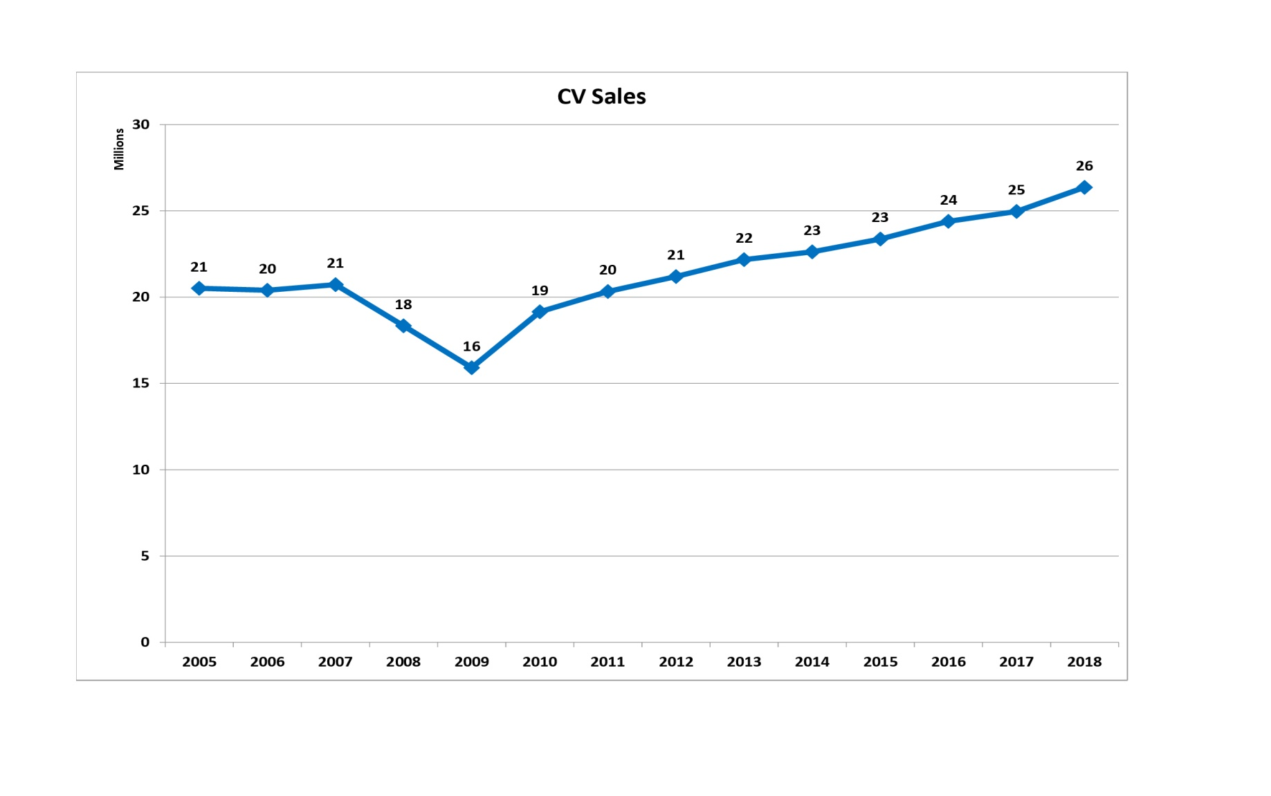
Commercial Vehicle Population
This line graph shows the total number of Commercial vehicles sold (in millions )till 2018

Slide 6
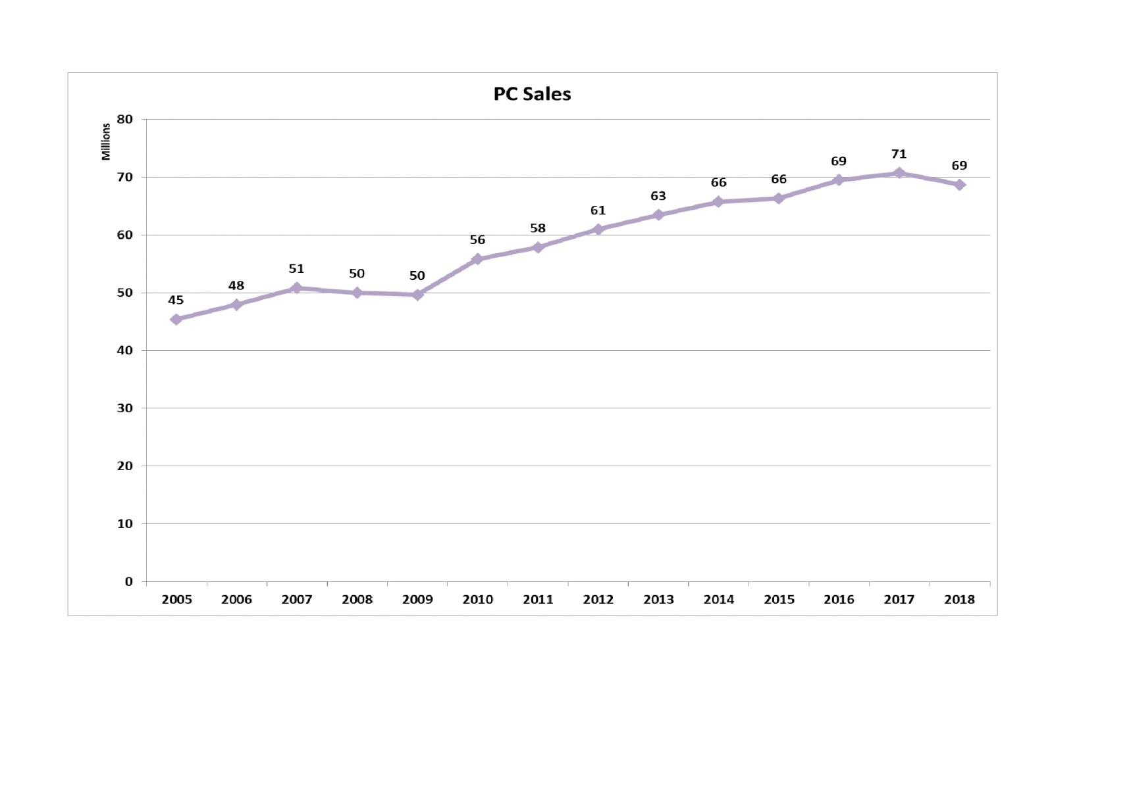
Private Vehicle Population
This line graph shows the total number of private vehicles sold (in millions )till 2018

Slide 7
The Vehicles’ Rulebook
There are some rules which every motorist whether a commercial vehicle owner or a private owner has to follow.
Wearing Seatbelts while driving a four or more wheeler vehicle.
Wearing helmets while driving a two wheeler.
Not to over-speed.
Don’t drink and drive.
Having important documents such as motor insurance and license.
Following traffic signals and rules.
And many more…

Slide 8
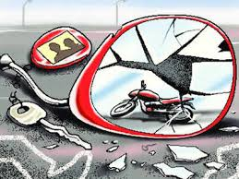
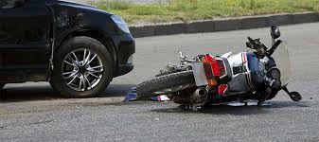
The Unwanted Penalty
Breaking of the above mentioned rules can lead to hefty penalty along with risking one or more life .
Breaking of these rules can lead to major accidents leading to incurable ailments , permanent physical damages or also death .
The following clearly shows the damage caused by accidents when some traffic rule are not followed.

Slide 9
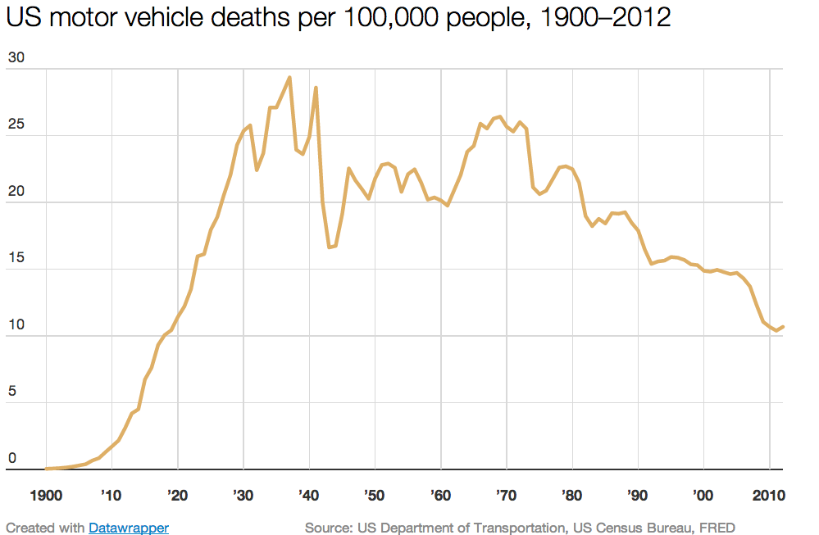
The Road Accident fatality chart
The fatalities caused by road accidents
graph beside shows that the awareness
about following traffic rules and
regulations on roads has decreased the
number of fatalities and has increased
the safety of human race on roads.

Slide 10
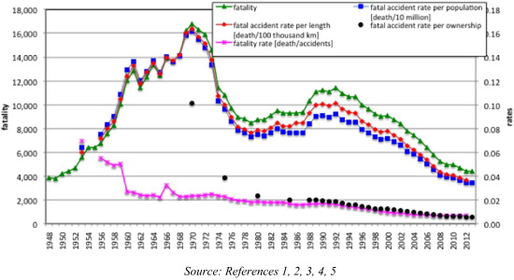
The Road Accident fatality chart
The fatalities caused by road accidents graph beside shows that the awareness about following traffic rules and regulations on roads has decreased the number of fatalities and has increased the safety of human race on roads.

Slide 11
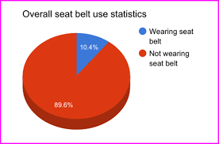
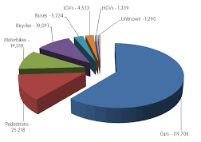
The Seat- Belt awareness still has least effect on stubborn motorists.
The following pie chart shows the number of deaths caused by the carelessness of various vehicles.

Slide 12
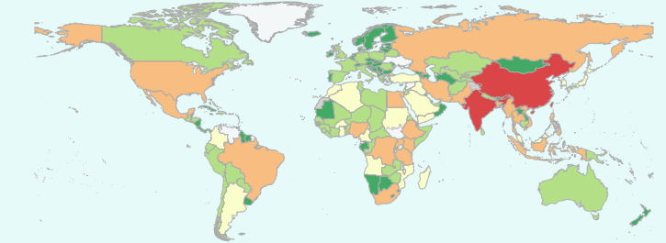
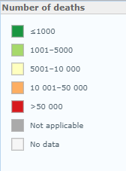
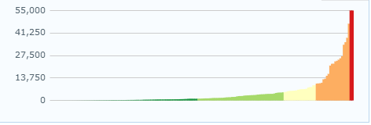
The following images and bar graph shows the number of death in different countries of the world with different regions as shown in above map.

Slide 13
Safety Standards
As we have seen in previous slides that the unwanted havoc created by the breaking of the traffic regulations must be reduced.
Thus there must be some strict safety rules and regulations which must be implemented.
Thus in the next slides there are some rules and safety instructions which must be implemented.
Some of them are : BAC limit , Seat-Belt Security , Speed limits , Helmet etc…

Slide 14
BAC (Blood Alcohol Concetration) Limit

Slide 15
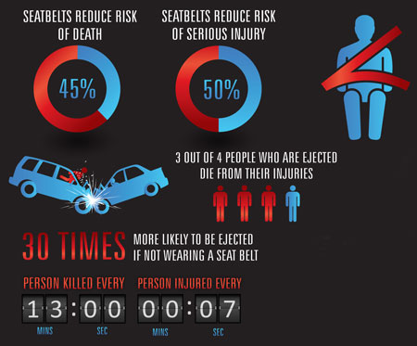
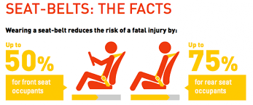
Seat - Belt Wearing Trends
The following images represent some facts related to the seat belts as seen in
general surveys. These images need no explanation as they are to be
understood by each and every
Motorist as it is for their safety.

Slide 16
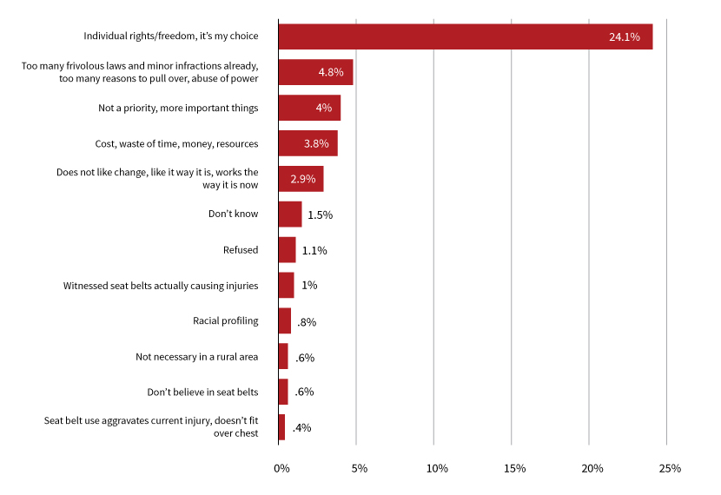
Some excuses given by motorists for not wearing seat belts

Slide 18
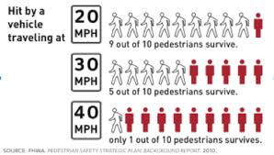
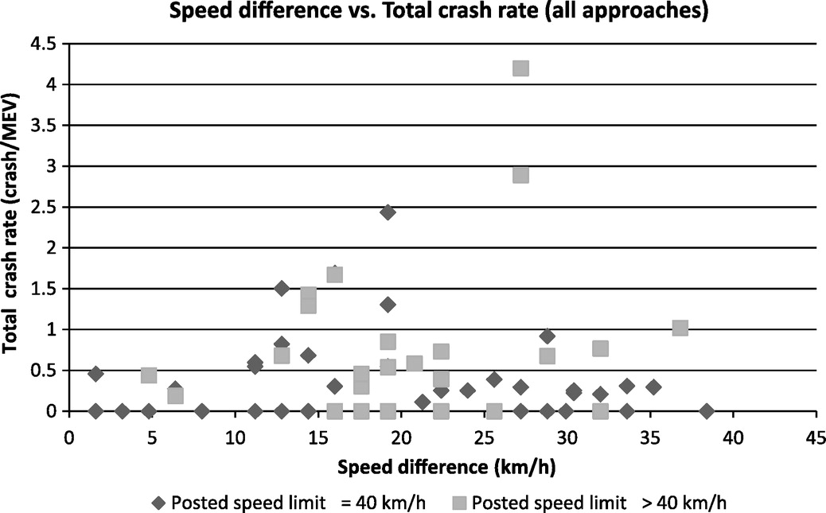
Speed – Limit Rates
The image shown beside shows the
casualties caused by over-speeding
Vehicles where low speed limits are to
Be maintained.

Slide 20
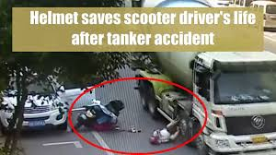
Security by using Helmet

Slide 21
